Slide 1
AVR project
Mobile controller home
Mohamed Mostafa Ganady
Atmega32

Slide 2
- Content :
- introduction
- Components
- Code
- The project

Slide 3
introduction
-Our project is a project to facilitate home control via mobile .
-Our project uses the Bluetooth For this control.
-Our project uses the keypad For this control.

Slide 4
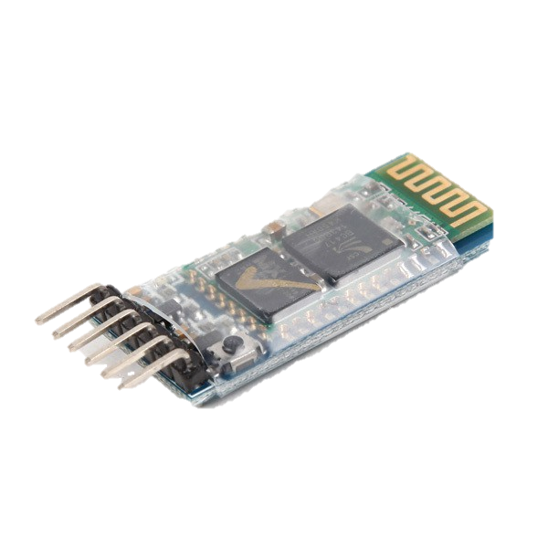
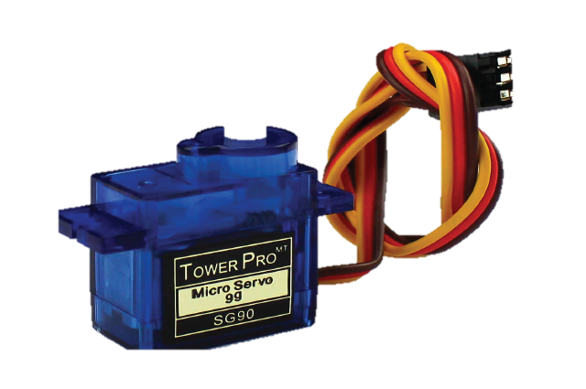
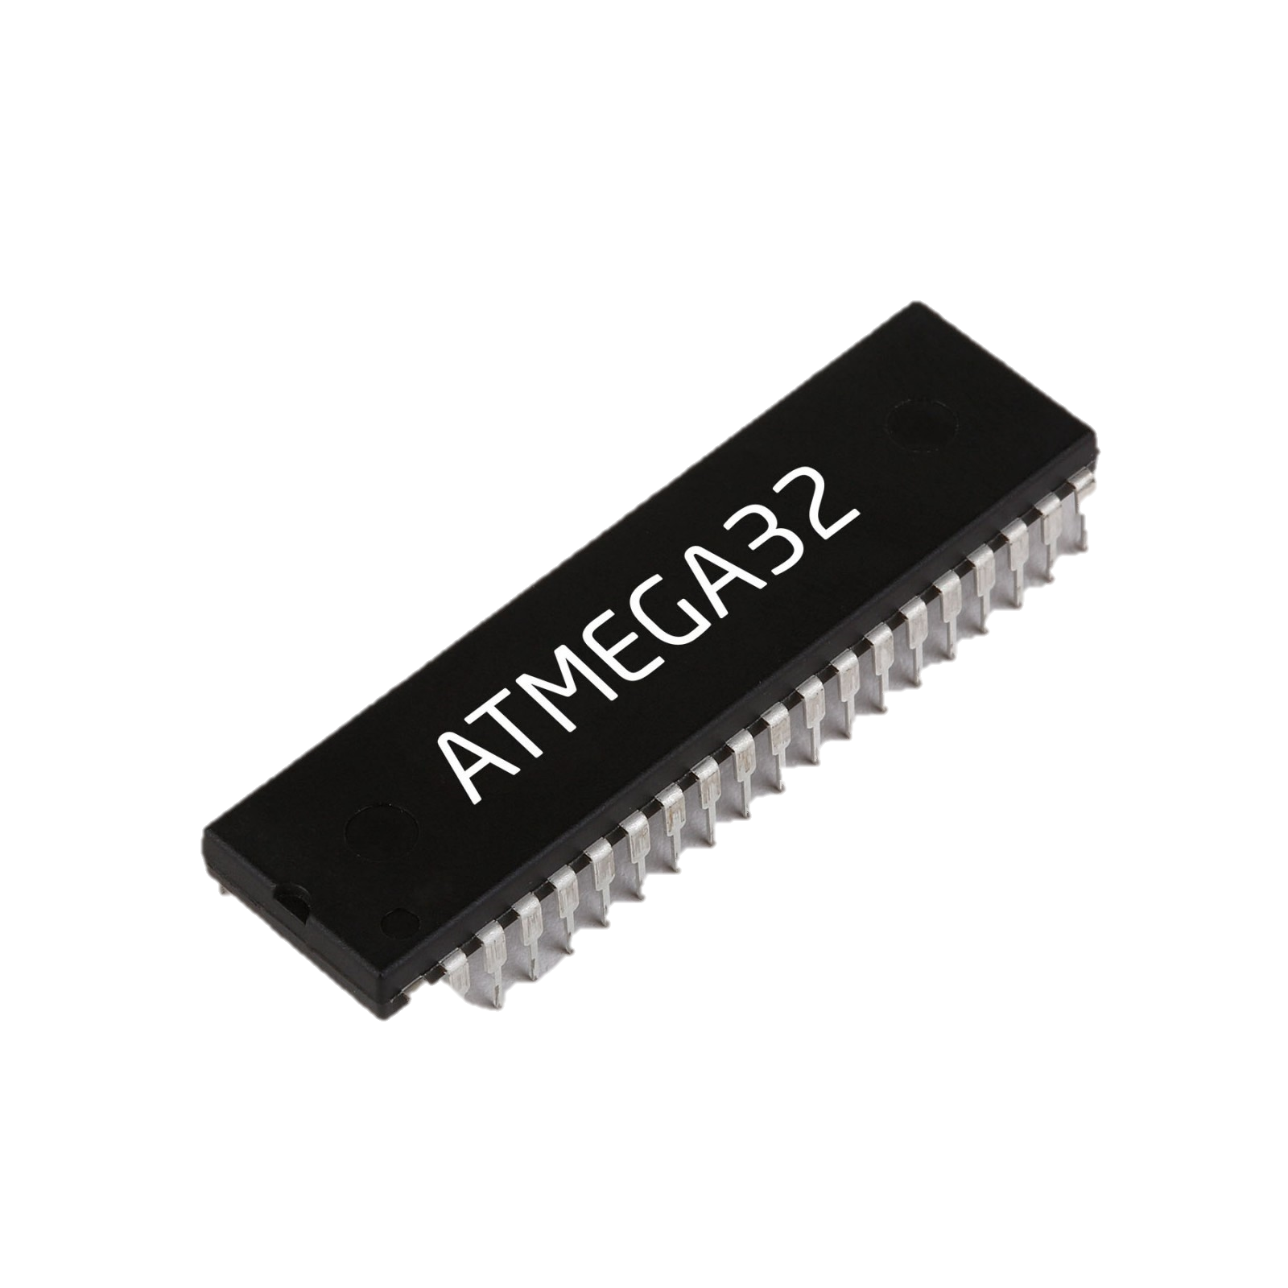
Components
Servo motor
Bluetooth module
AVR
Atmega32

Slide 5
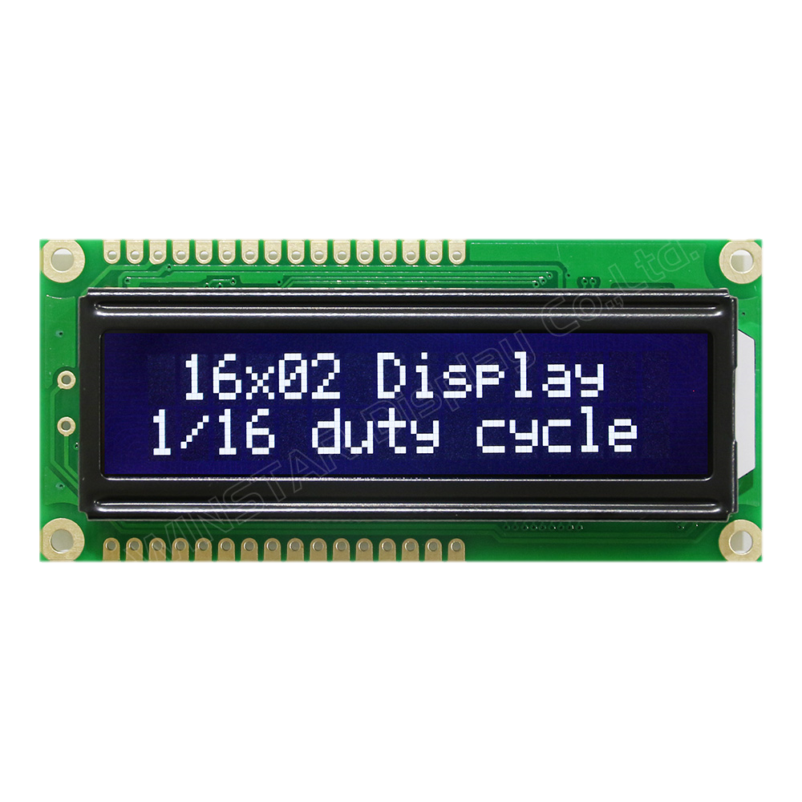
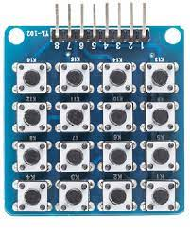
Components
Keypad
LCD

Slide 6
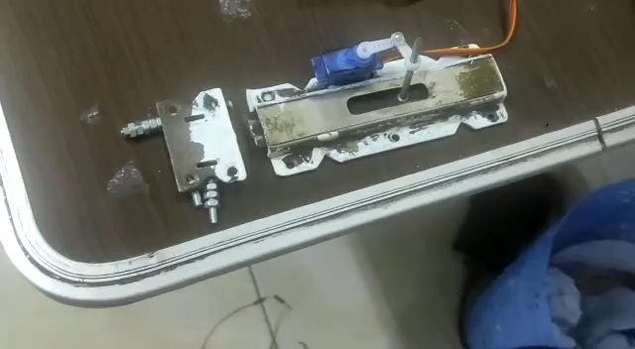
Let’s see the project

Slide 7
start
U8 data_of_keypad=1
U8 data_from_mobile=1
U8 number_of_digit=0
U8 close_flag=0
U16 sum_of_digit=0
U8 flag=0
U8 num_of_trying=0

Slide 8
Printf”enter password”
Point A
Data_of_keypad= get_data()
Data_of_mobile = get_valu()
If
Data_of_keypad>0
&&
Data_of_keypad !=“+
&&
Data_of_keypad!=“/”
&&
Close_flag==0

Slide 9
No
yes
If
Flag==0
If
Data_of_keypad==‘+’
||
data_of_mobile==‘f’
&&
Close_flag==o
no
yes
Sum_of_gidit*=10+(data_of_keypad-’0’)
Clear LCD
yes
NO
Clear LCD
Num_of_digit++
Flag=0
Slide 12
To
Point
A
Sum_of_digit=0

Slide 10
Num_digit=0
If
Sum_of_digit==password
||
Data_of_mobile == ‘f’
No
yes
Sum_of_digit=0
Num_of_trying++
Close_flag=1
Sum_of_digit=0
Print ” wrong password ”
Print”the system is open”
Servo_angle(open)
Print ” try again”
Clear LCD
Point A

Slide 11
If num_of_trying>3
No
yes
Print ” Enter password”
Print ” system is not safe”
While
Num_of_Trying<=3
No
yes
Buzzer on
LED on

Slide 12
If
Close_flag==1
&&
Data_of_keypad==%
Data_of_mobile==‘b’
To point A
yes
Sum_of_digit=0;
Close_flag=0;
Data_of_keypad=1;
Clear LCD
Print”the system closed”
Servo_angle(close)

